Slide 1
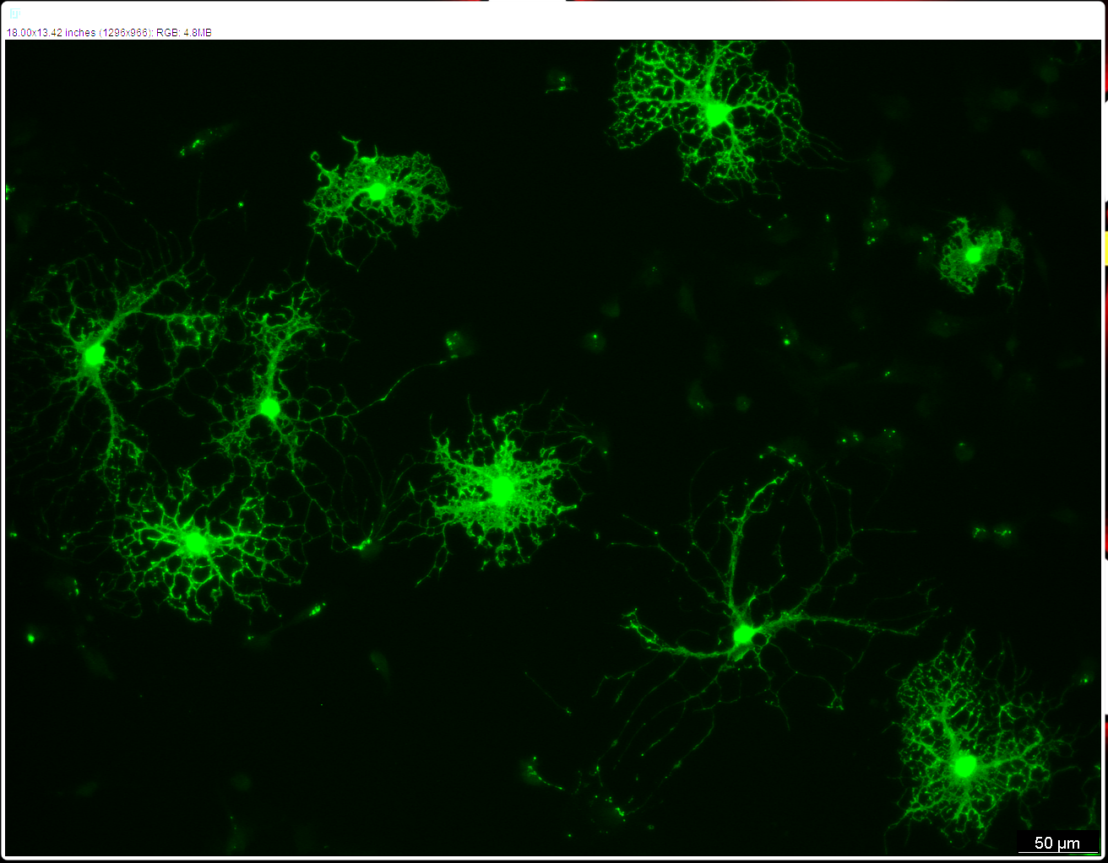




Oligodendrocyte myelination and maturation defects in Parkinson’s Disease
Jose Maria Salazar Campos
Burbulla Lab
NECTAR 2025
21.10.2025

Slide 2
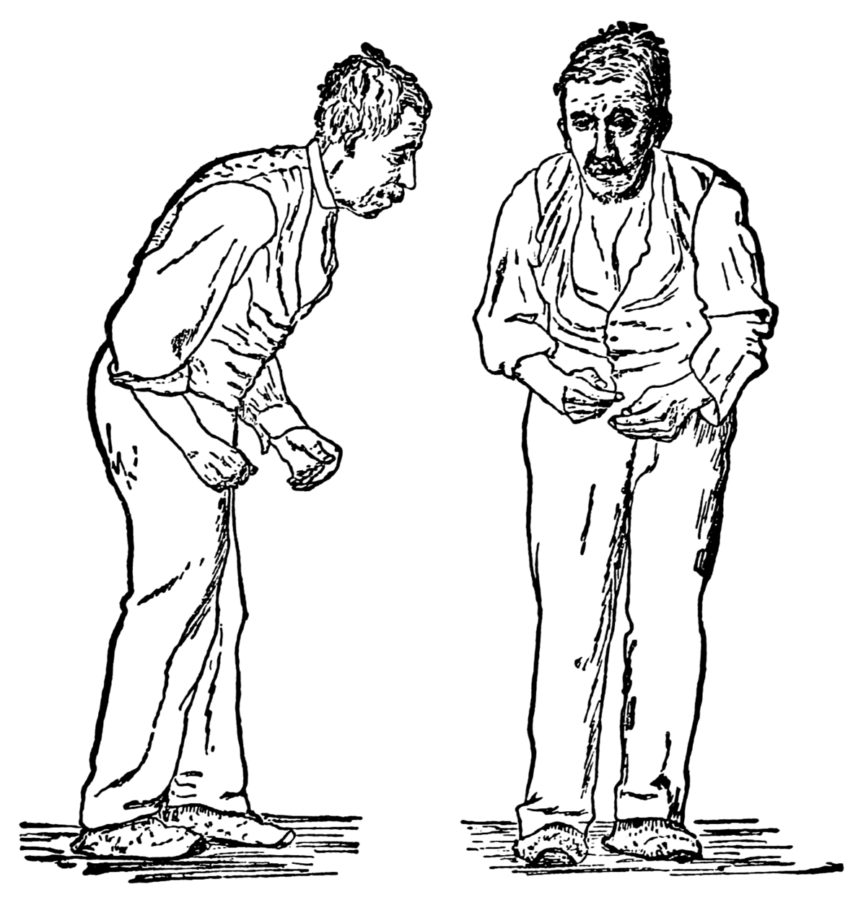
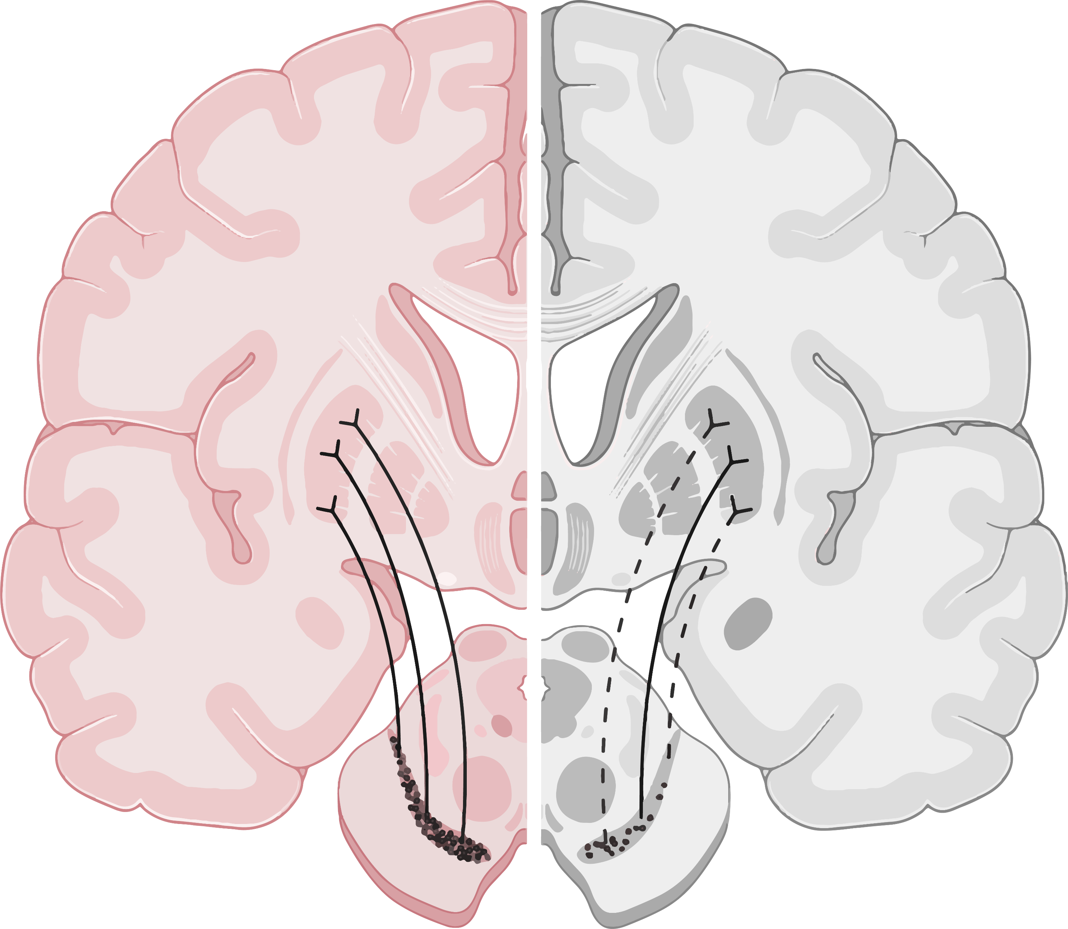
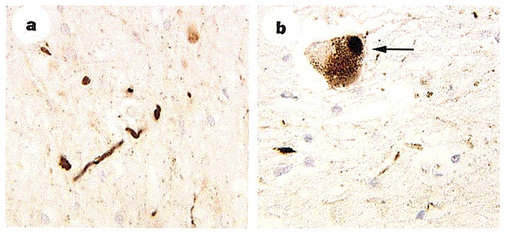

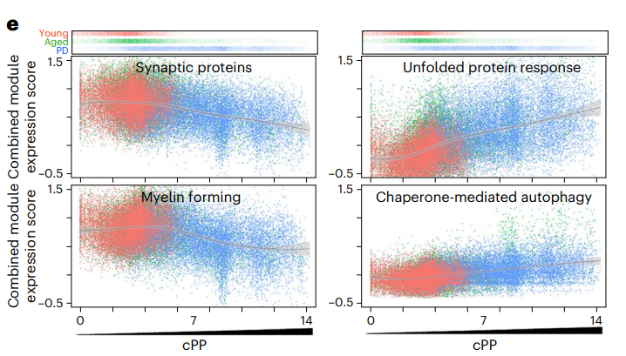
Parkinson’s disease
Healthy
Parkinson’s disease
Spillantini et al., Nature, 1997
Adams et al., Nature Aging, 2024
Bryois et al., Nature Genetics, 2020
Notes:
Ask Francesco for image of the axons degenerating

Slide 3
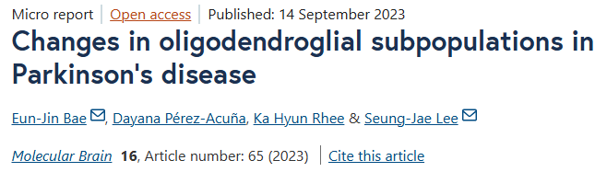
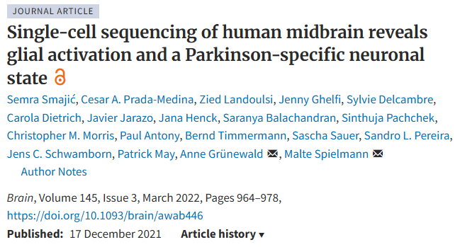
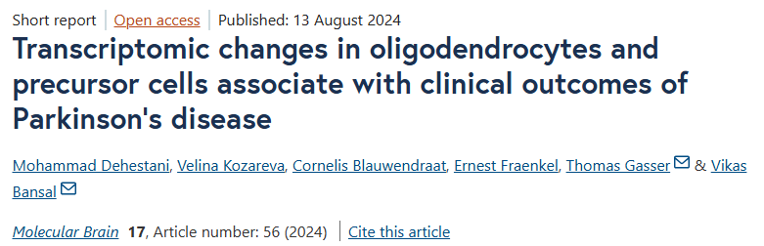
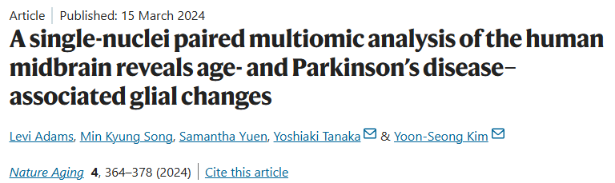
Healthy
Parkinson’s disease

Slide 4
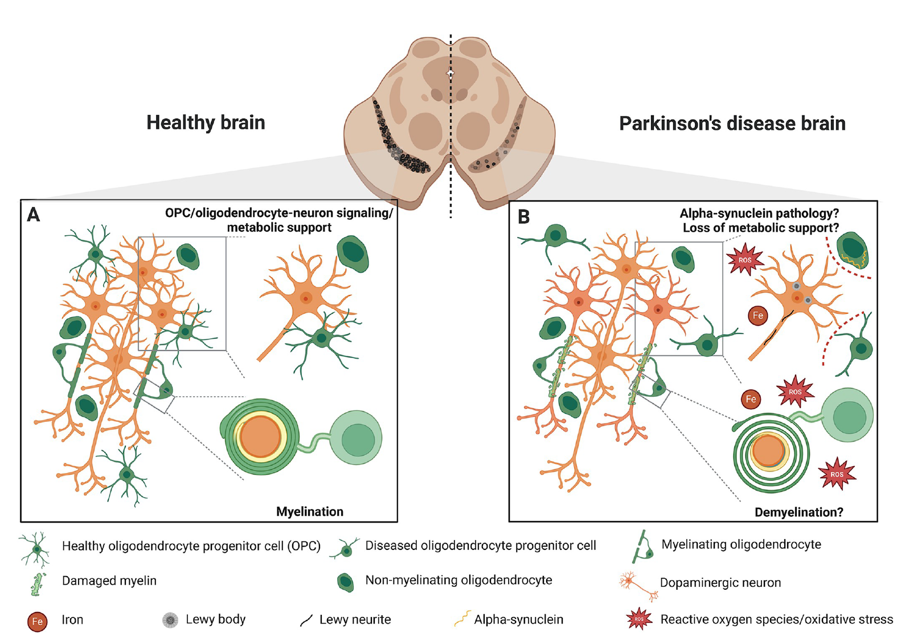
Salazar et al.,
Plos Biology, 2025

Slide 5
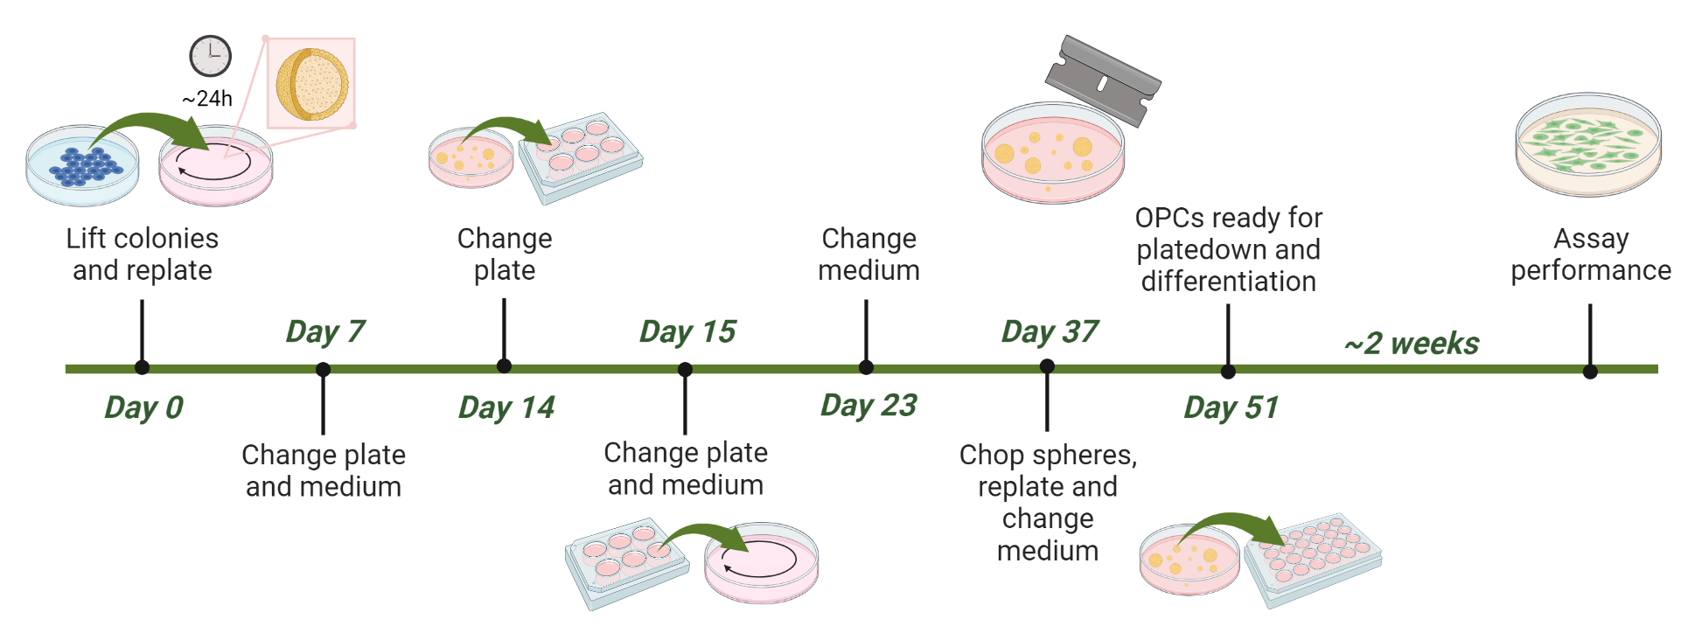
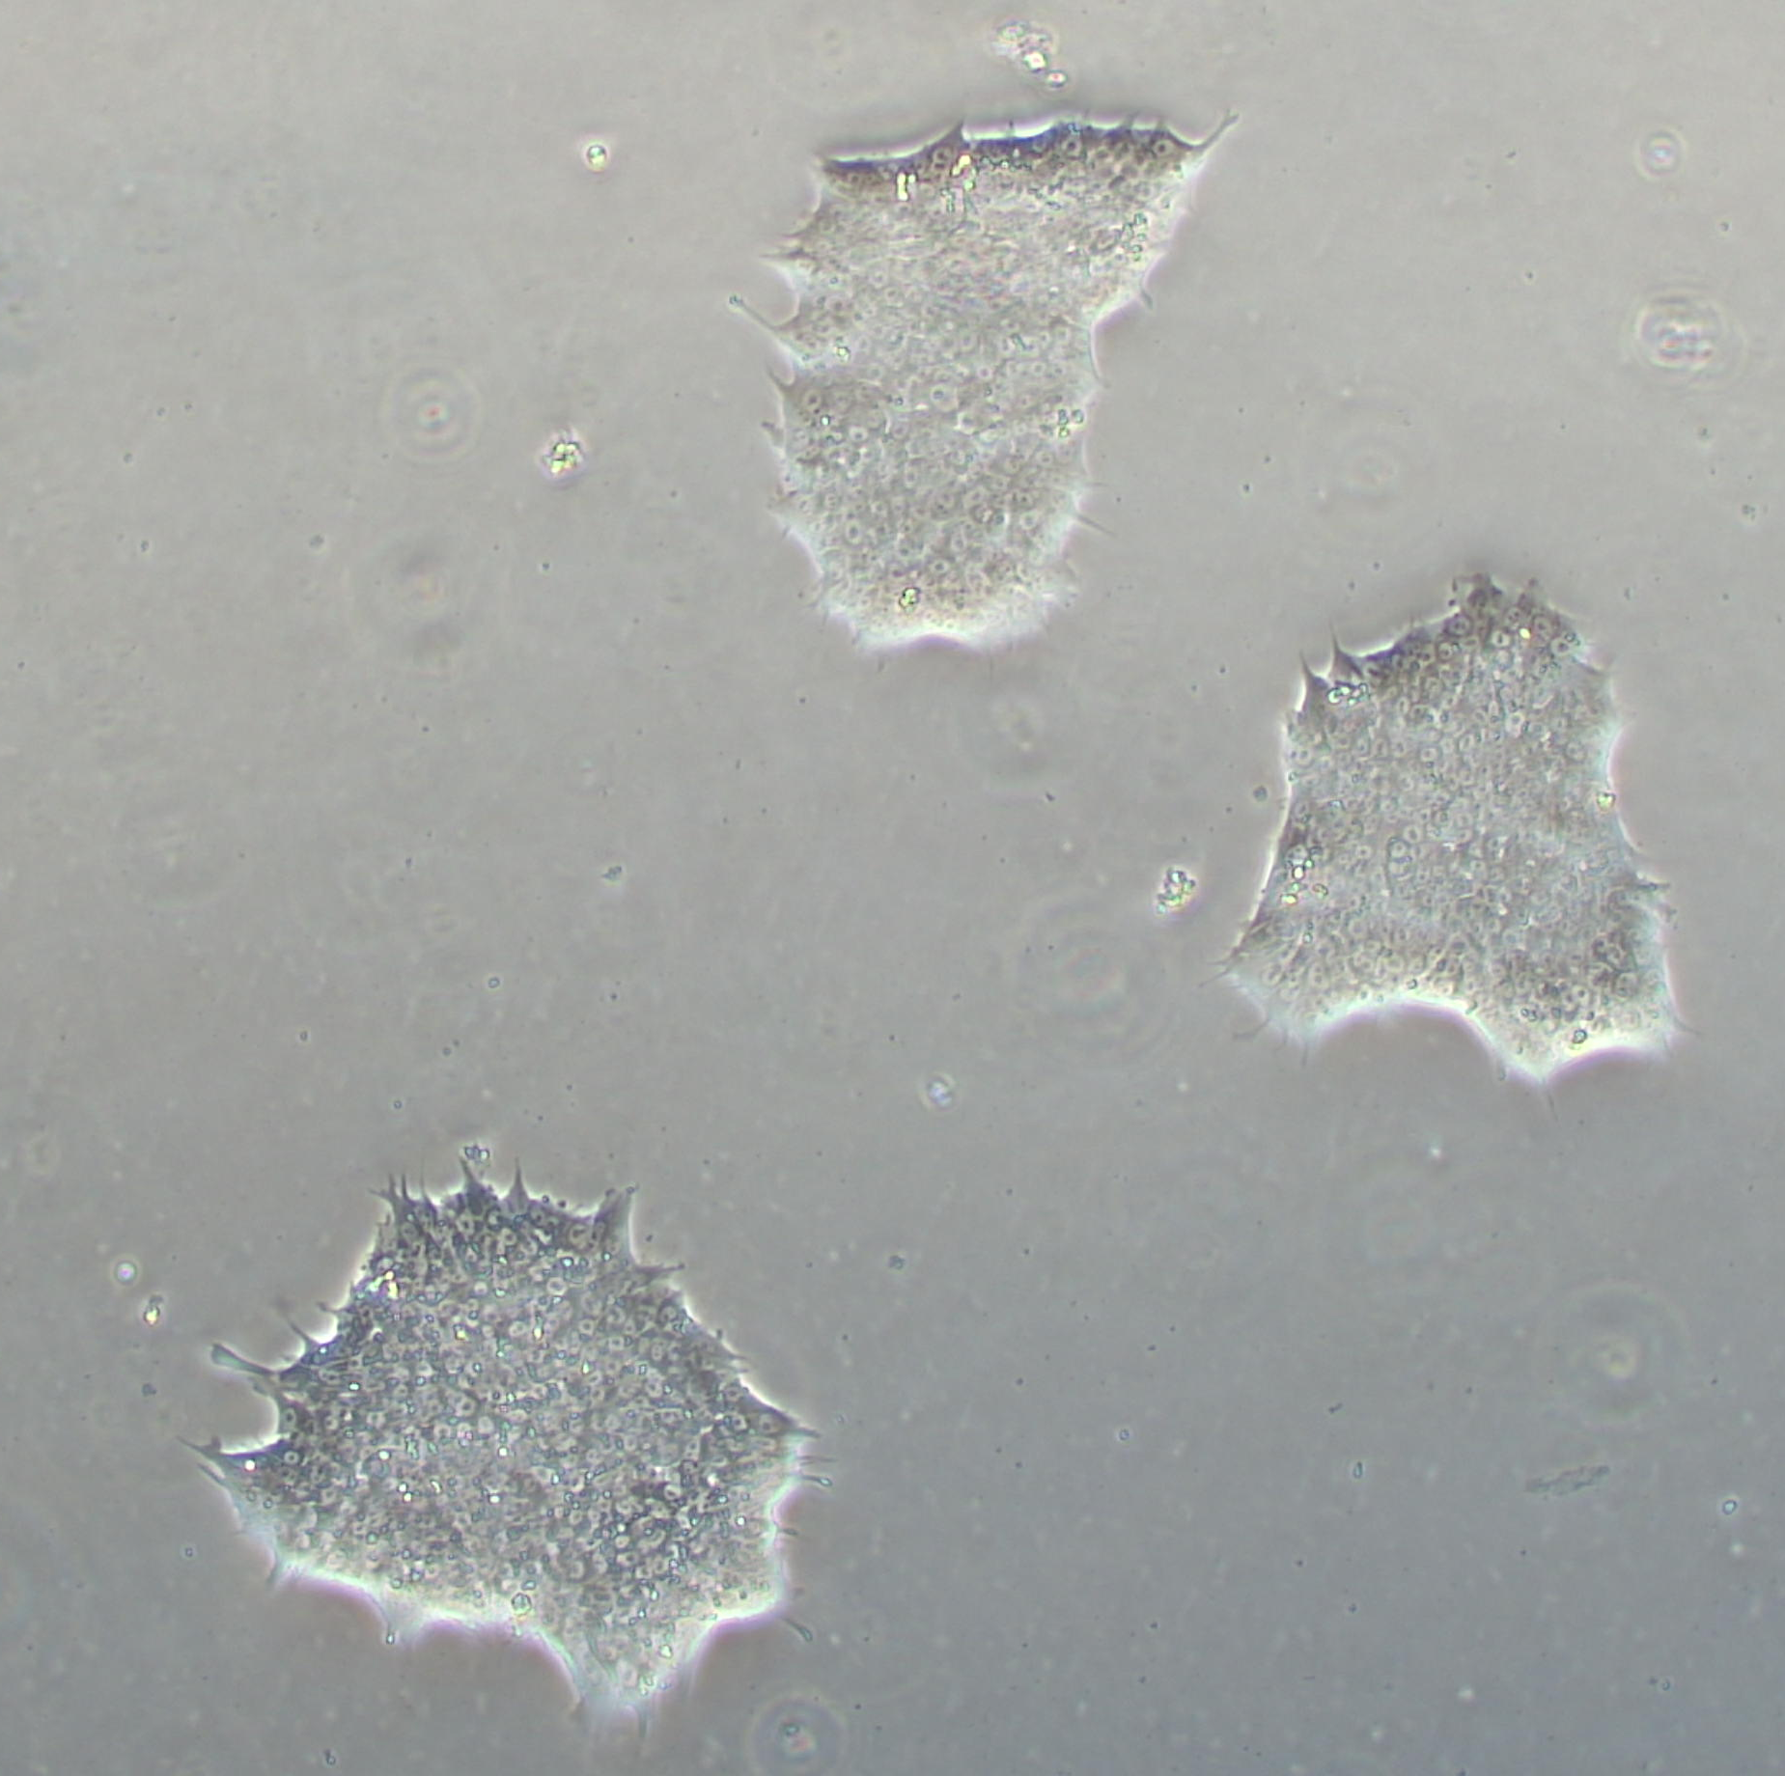
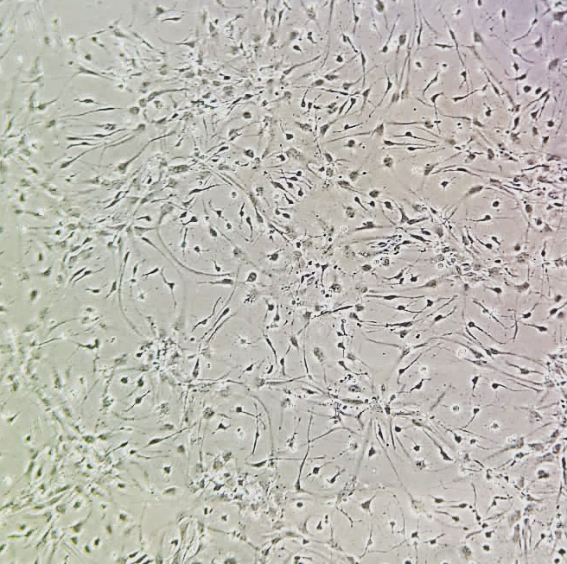
iPSC differentiation into oligodendrocytes

Slide 6
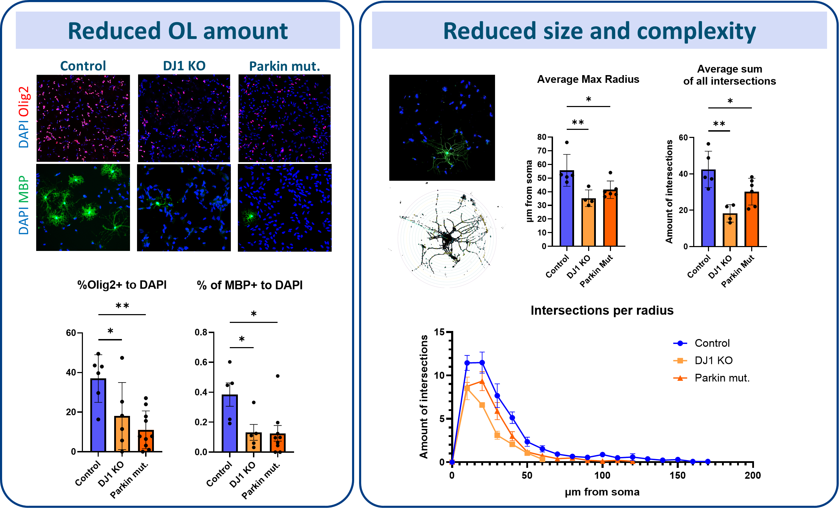
Loss of oligodendrocytes and deficits in maturation
Notes:
In the MACS part I would mention having “more pure” cultures and also to isolate for WB and/or qPCR, I would also mention the alternatives to the previously mentioned assays as a backup in case they don’t work

Slide 7
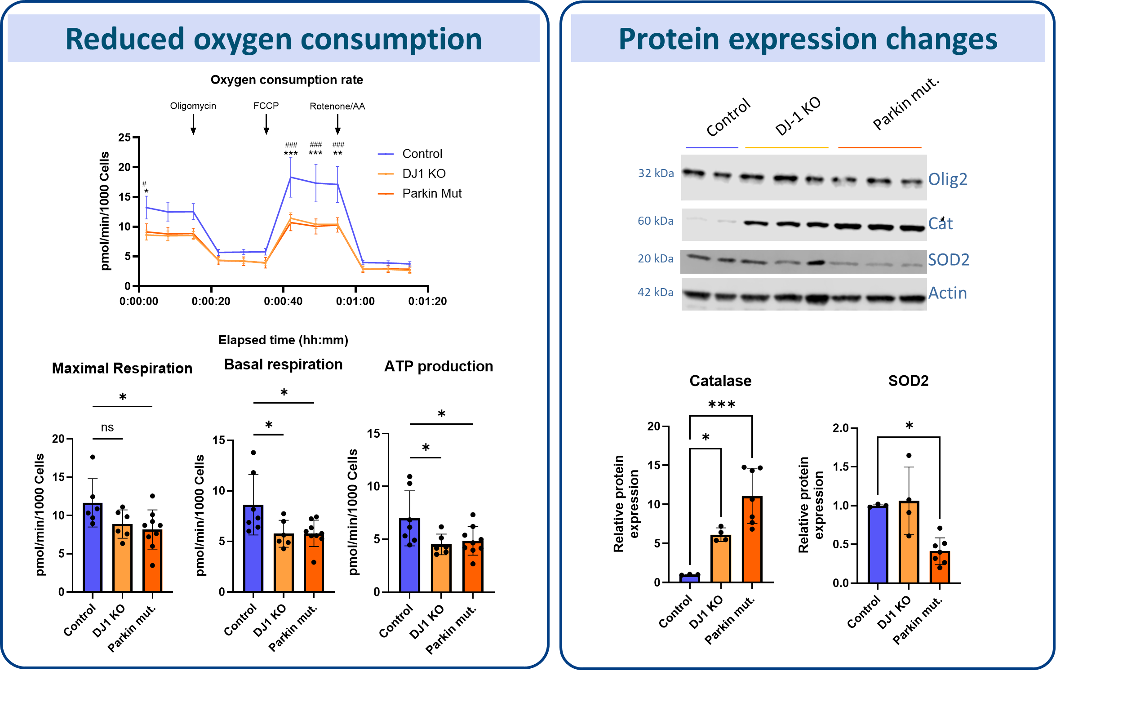
Mitochondrial defects and oxidative stress
Notes:
In the MACS part I would mention having “more pure” cultures and also to isolate for WB and/or qPCR, I would also mention the alternatives to the previously mentioned assays as a backup in case they don’t work

Slide 8
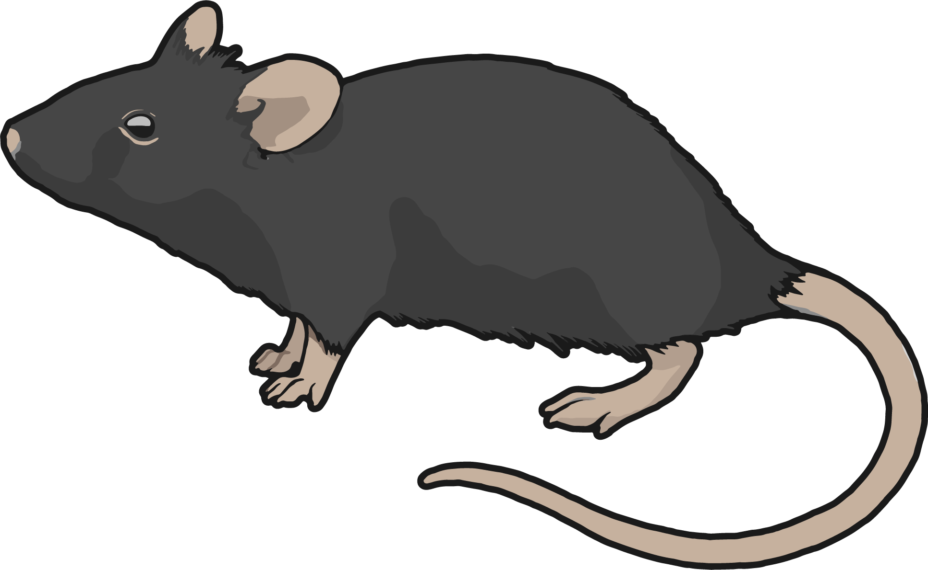
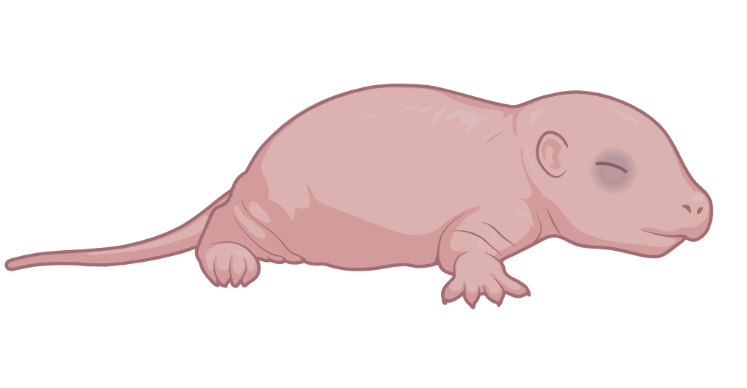

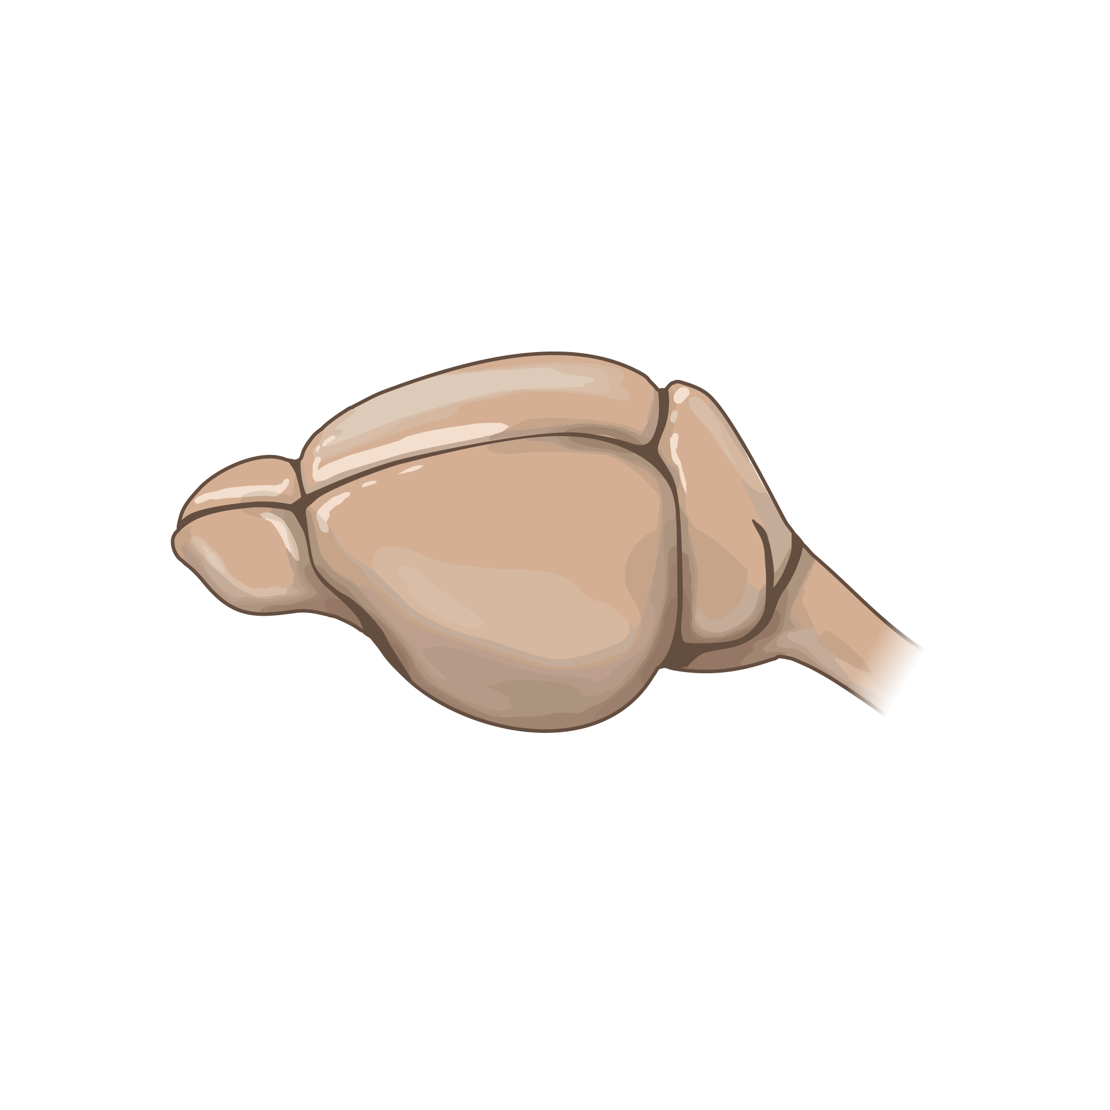
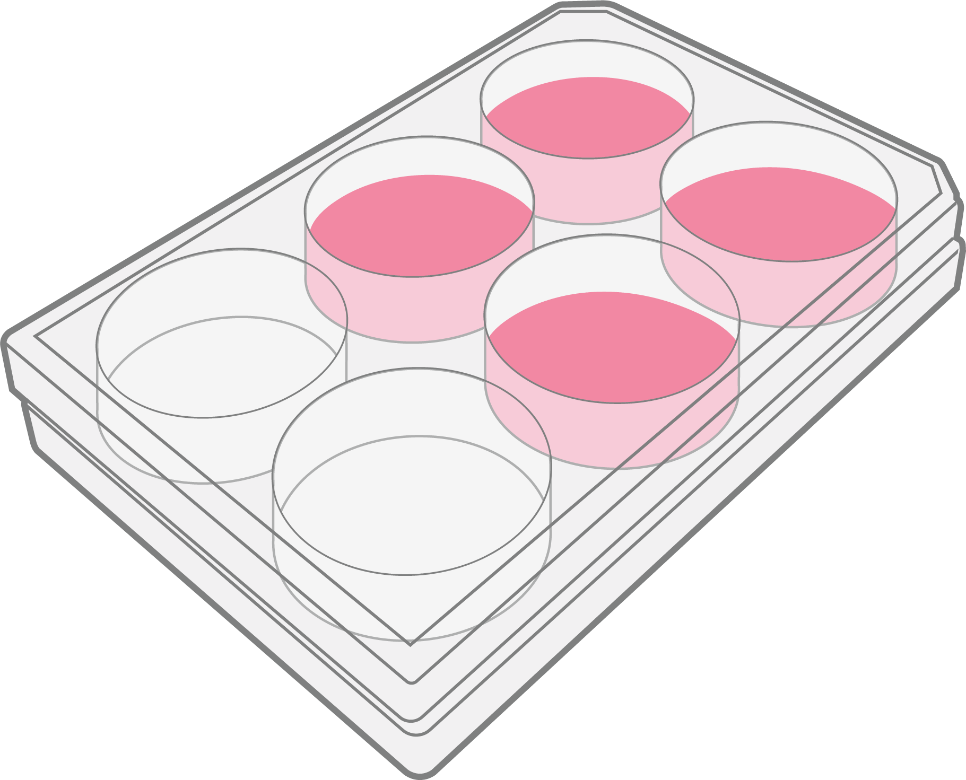
Ex vivo cultures
iPSC-derived oligodendrocytes
C57BL/6 mice
Postnatal day 4
Cerebellum slices
Notes:
Slide in between to explain this model

Slide 9
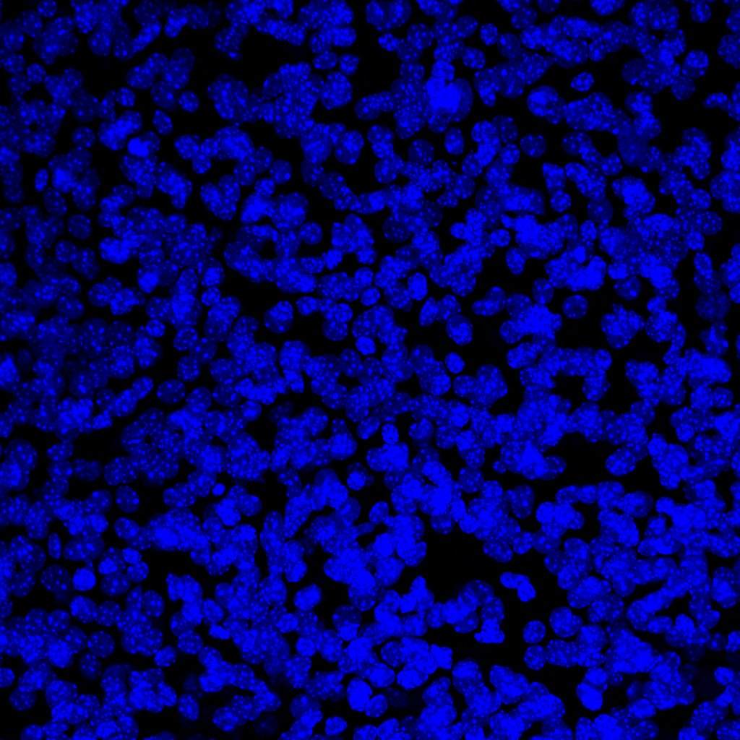
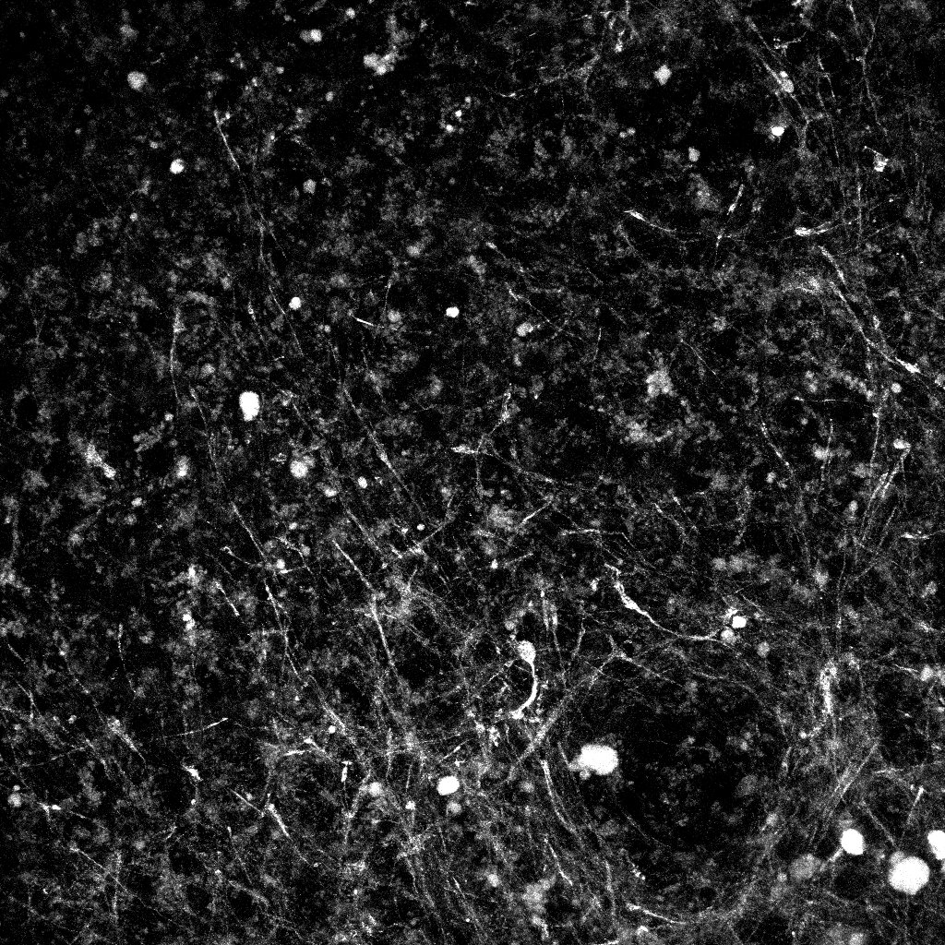
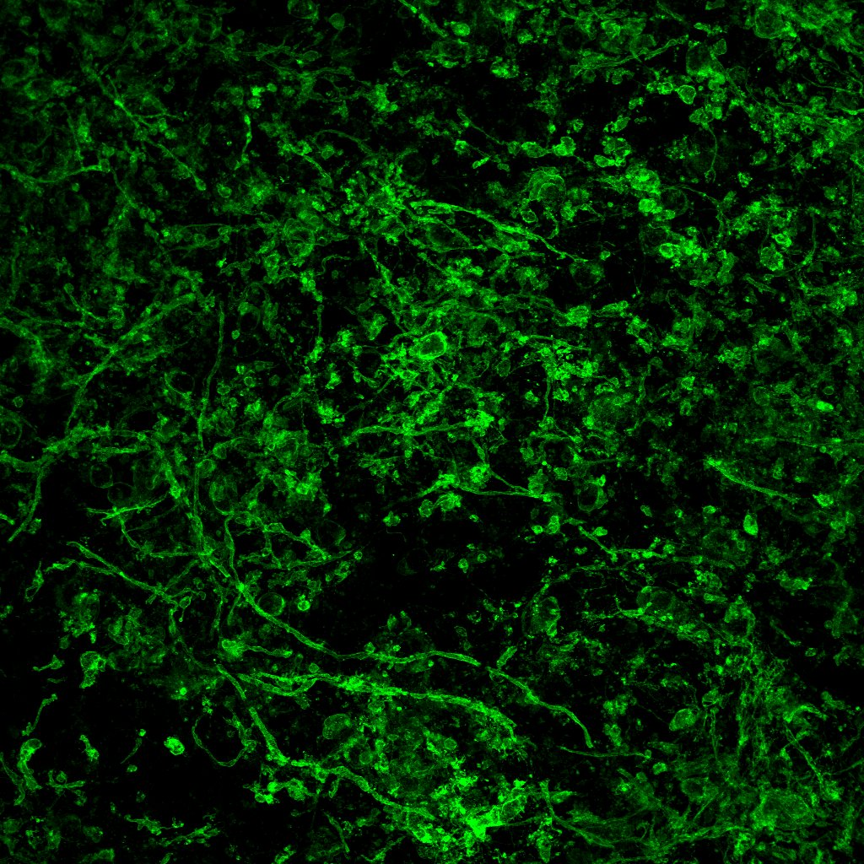
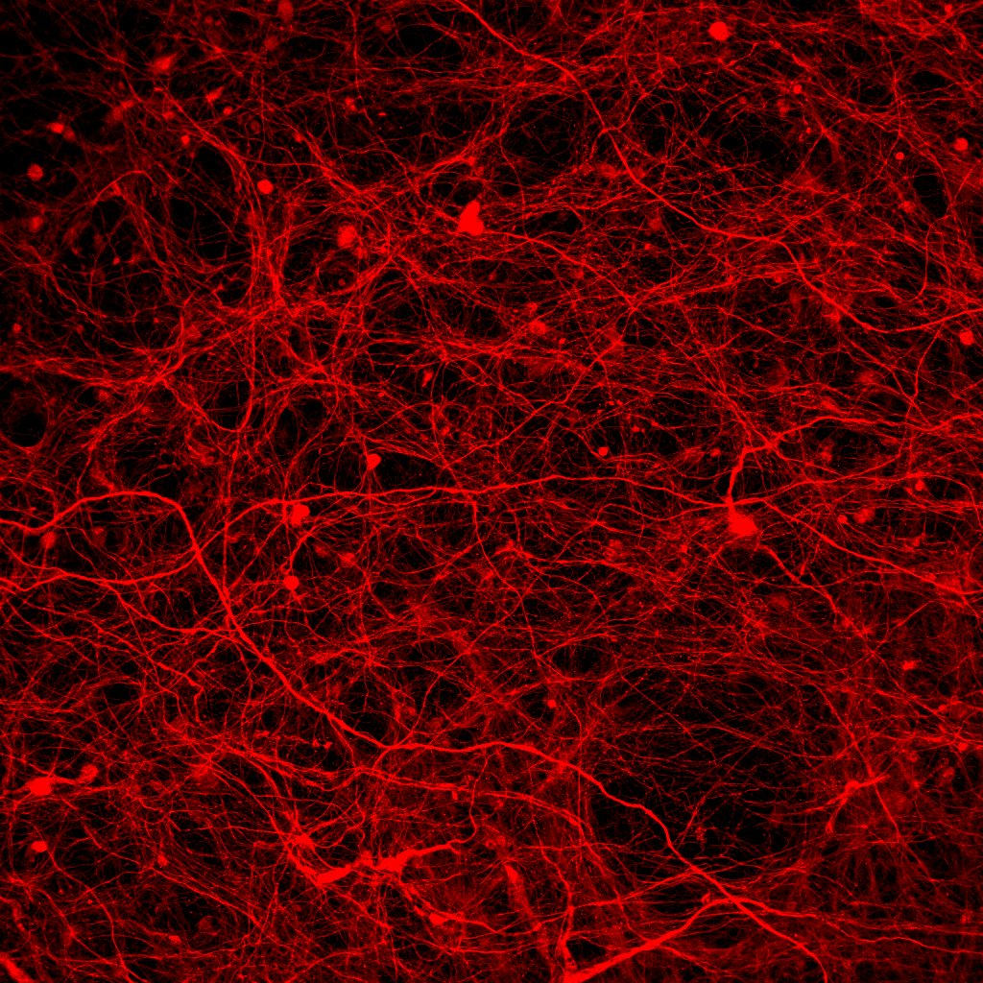
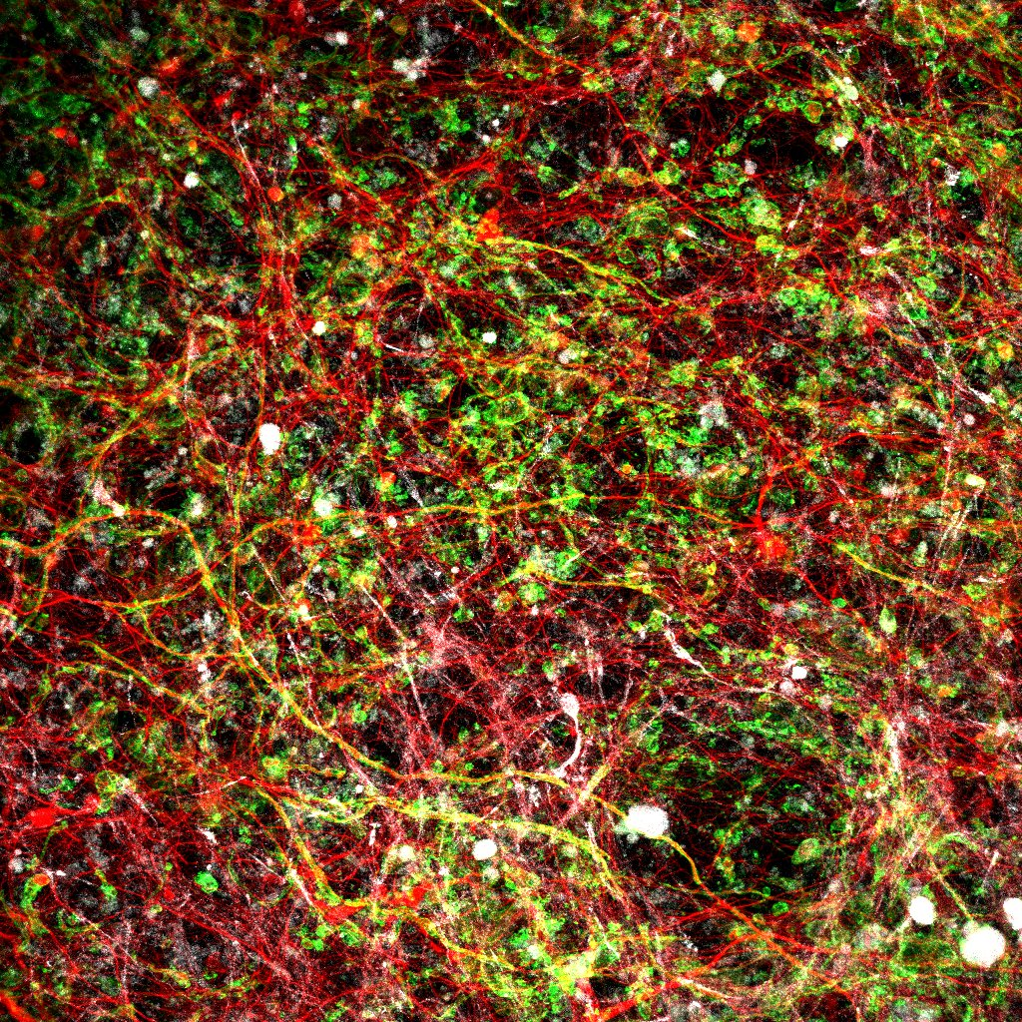
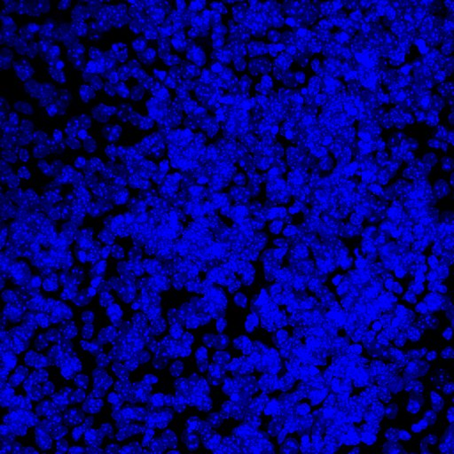
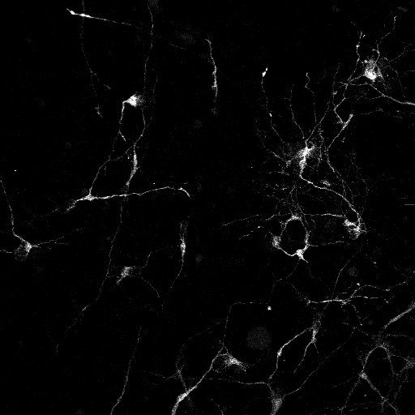
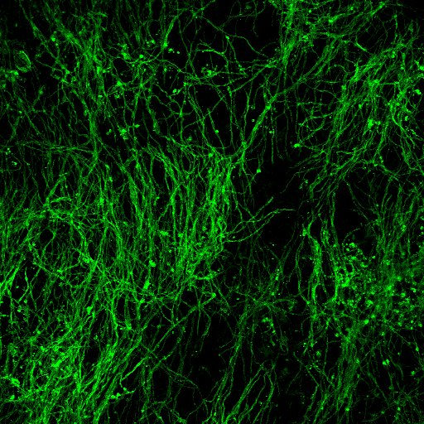
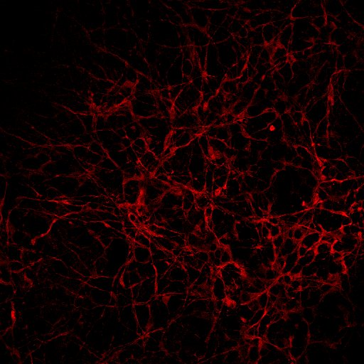
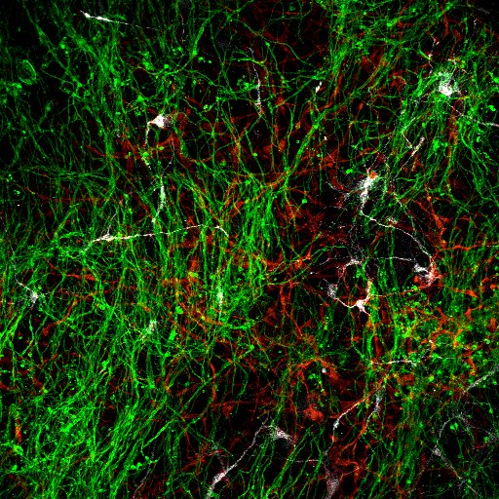
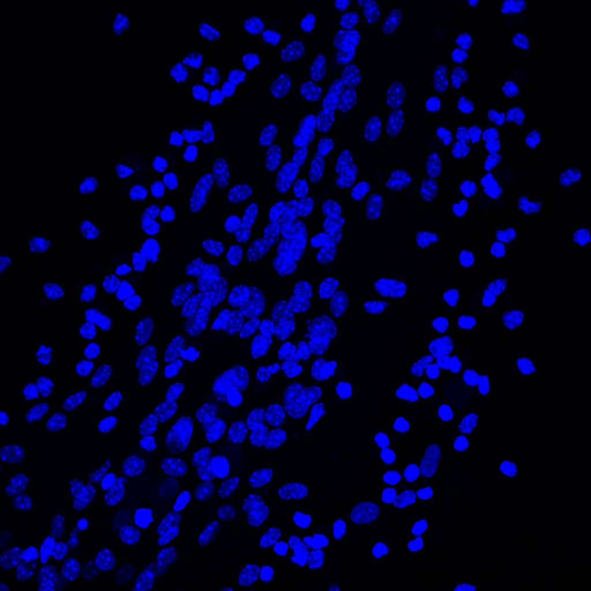
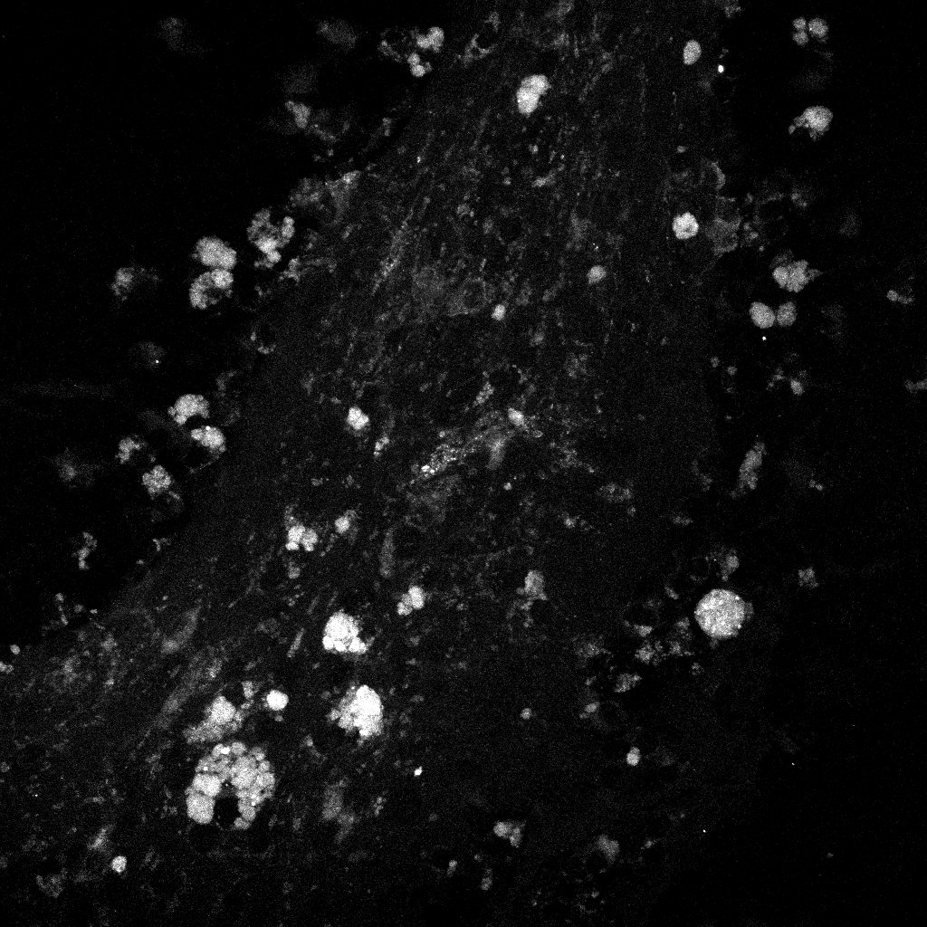
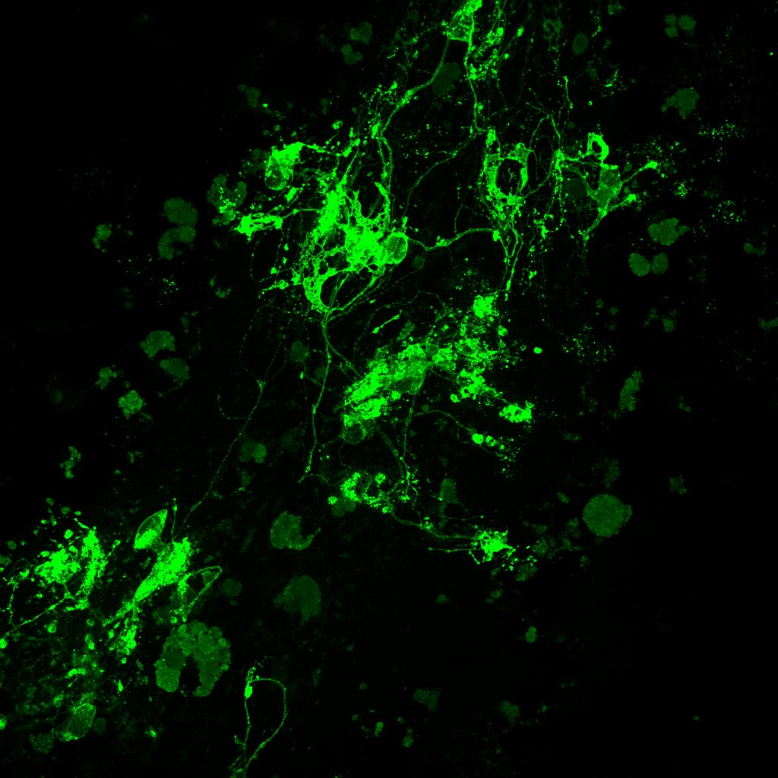
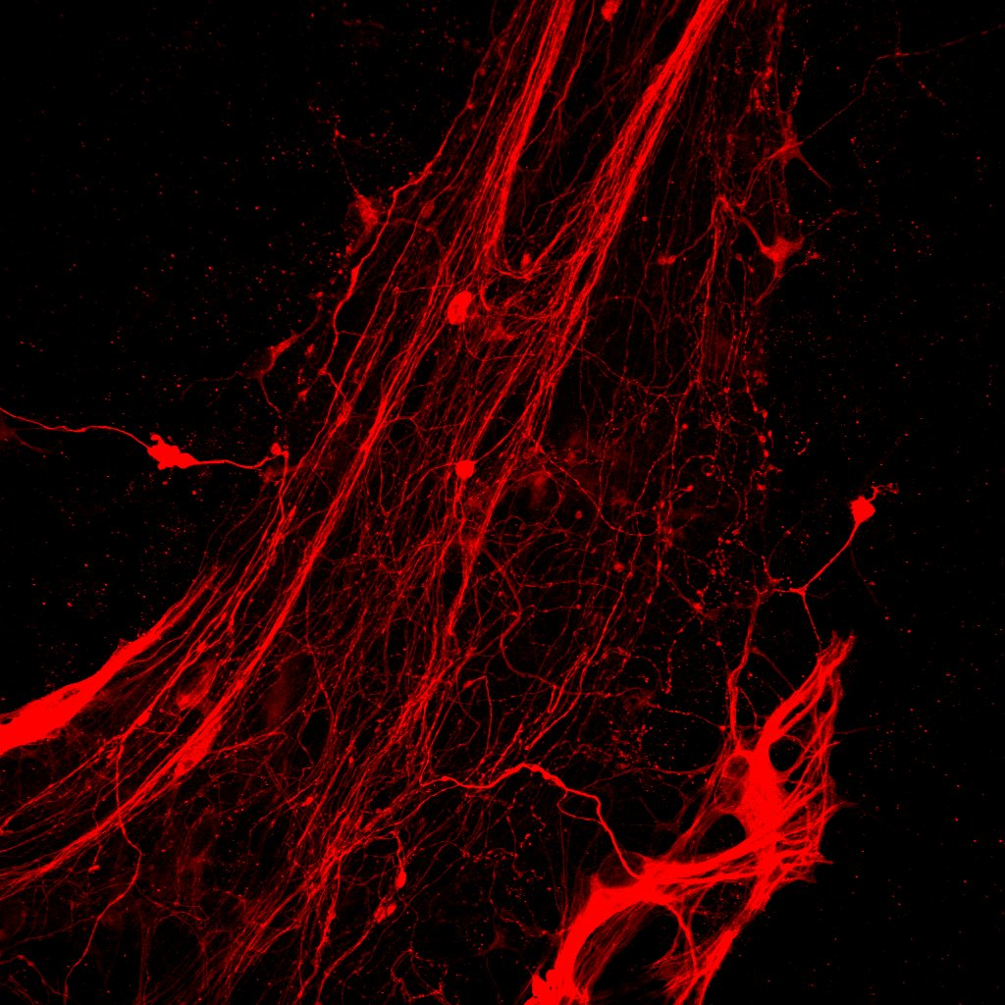
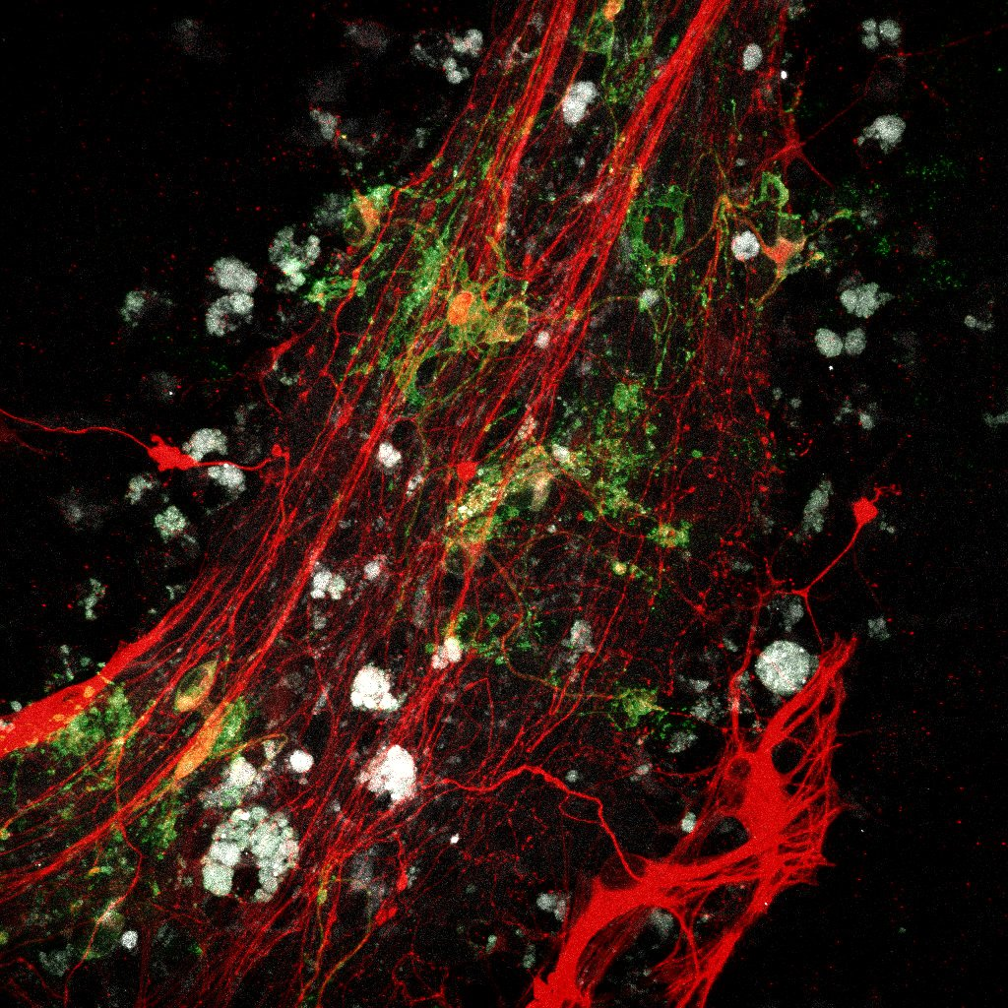
Reduction in myelinating capacities
DAPI
Stem121
MBP
B-3-Tubulin
Merge
Control
DJ1 KO
Parkin mut.
*With the help of Lisa Evangelista

Slide 10
Take home message
Familial PD iPSC-derived oligodendrocytes suffer differentiation and maturation defects
They also exhibit impaired mitochondrial function with signs of elevated oxidative stress
Addition of PD oligodendrocytes onto ex vivo mouse brain slices show reduced myelinating capacities
Maturation
Mitochondrial function
Oxidative stress
Myelination

Slide 11
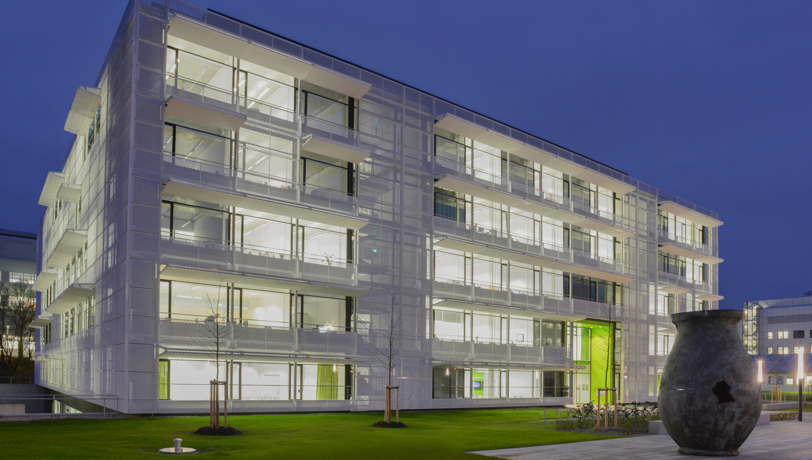
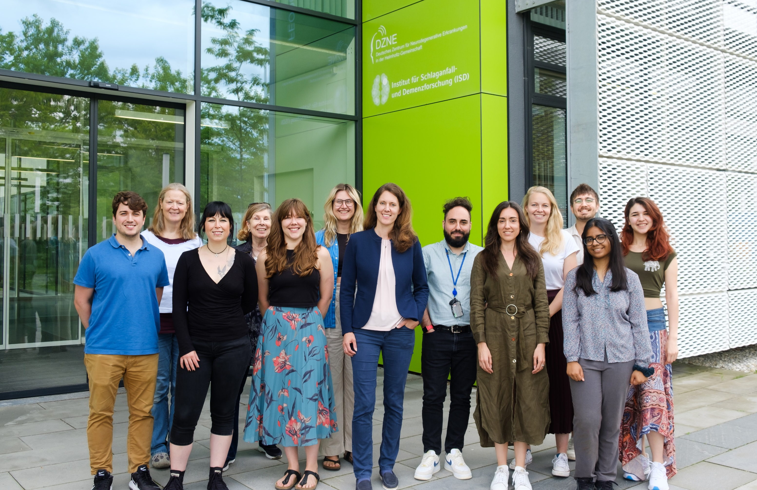
Disease associated mutations impair TREM2 shedding
Burbulla Lab
Lena Burbulla
Francesco Gubinelli
Annika Wagener
Leonie Heger
Andreas Huber
Gamze Özata
Carla Kolb
Veronika Müller
Lena Jaschkowitz
Ferdinand Graziotto
Caterina Mongiello
*Aida Cardona-Alberich
*Rachel Wise
*Clara Kaufhold
*Naiyareen Fareeza Mayeen
*Leonie Kertess
*Katerina Chrisostomidou
*Ambika Singh
Jaekel Lab
Sarah Jaekel
Lisa Evangelista
Charlene Hurler
Courtney McQuade
Nadia Dorosti
Kerschensteiner Lab
Martin Kerschensteiner
Arek Kendirli
Franz Bauernschmitt
Lichtentaler Lab
Stefan Lichtentaler
Stefan Müller

